Slide 1
Capital Budgeting
Harsh Pratap Singh

Slide 2
Investment Decision
A financial decision which is concerned with how the firm’s funds are invested in different assets is known as investment decision.
A long term investment decision is called capital budgeting decisions which involve huge amounts of long term investments and are irreversible except at a huge cost.

Slide 3
Capital Budgeting Decision
Capital budgeting is the making of long-run planning decisions for investments in projects and programs.
With the capital budgeting decision, the financial manager decides where best to deploy monies long-term. The purchase of a new delivery truck or a new warehouse is a capital budgeting decision; the payment of a utility bill is not.
With the making of this decision, we consider three features of the cash flows deriving from the decision:
The size of the cash flows
The timing of the cash flows
The risk of the cash flows

Slide 4
Conti…
Capital Budgeting is a decision-making process where a company plans and determines any long term Capex whose returns in terms of cash flows are expected to be received beyond a year. Investment decisions may include any of the below:
Expansion
Acquisition
Replacement
New Product
R&D

Slide 5
Why investment decision important?
They influence firms growth in the long run
They affect the risk of the firm
They involve commitment of large amount of funds
They are irreversible, or reversible at substantial loss
They are among the most difficult decision to make

Slide 6
Investment Project Evaluation
Tapping the environment to generate the investment proposal
Develop a long term investment plan
Estimation of Cash Flow pattern for investment Projects
Estimation of required rate of return
Apply the capital budgeting Technique to evaluate the projects
Implement selected Project
Monitoring and Post Audit of the investment Project

Slide 7
Types of Projects
Mandatory Investments
Replacement Projects
Expansion Projects
Diversification Projects
Research and Development Projects

Slide 8
investment criteria
A wide range of criteria has been suggested to judge the worthwhileness of investment projects.
The important investment criteria, classified into two broad categories –
discounting criteria and
non-discounting criteria

Slide 9
Methods of Capital Budgeting
Traditional or Non Discounted Methods
Pay Back Period Method
Accounting rate of return Method (ARR)
Modern and Discounted Methods
Net Present Value method (NPV)
Benefit-cost ratio/Profitability Index (PI)
Internal Rate of Return Method (IRR)

Slide 10
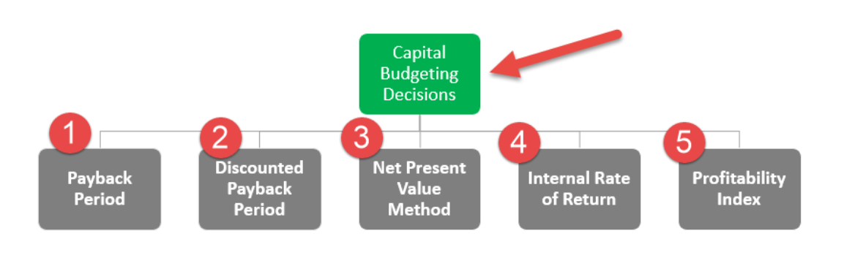
Methods for Capital Budgeting

Slide 11

Net Present Value Method
Net present value (NPV) is a method used to determine the current value of all future cash flows generated by a project, including the initial capital investment.
It is widely used in capital budgeting to establish which projects are likely to turn the greatest profit.
NPV = [CF_{i1}/ (1+r)¹ + CF_{i2}/(1+r)² + CF_{i3}/(1+r)³ + …] – C_{o}

Slide 12
Acceptance Rule
Accept the project when NPV is Positive
Reject the Project when NPV is Negative
May accept the project when NPV is zero

Slide 13
Example
Hills Ltd. would like to invest in a new project. The company has the following information for this new investment –
Cost of the new investment as of now – $265,000
The project will receive cash inflows as follows –
Year 1 – $60,000
Year 2 – $70,000
Year 3 – $80,000
Year 4 – $90,000
Year 5 – $100,000
Find out the NPV and conclude whether this is a worthy investment for Hills Ltd. Assume the required rate of return as 10%.

Slide 14
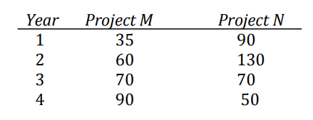
Example
Your company is considering two projects, M and N. Each of which requires an initial outlay of Rs.140 million. The expected cash inflows from these projects are:
The cost of capital is 10 percent? What is NPV of both the projects?
If both the projects are mutually exclusive, which one should be selected?

Slide 15
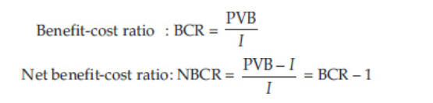
Profitability Index Method
The formula for Profitability Index is simple and it is calculated by dividing the present value of all the future cash flows of the project by the initial investment in the project.
Profitability Index = PV of future cash flows / Initial investment

Slide 16
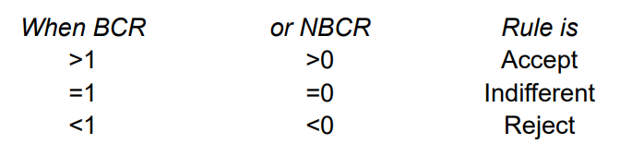
Accept/Reject Criteria

Slide 17
Example-4
Project A needs an initial investment of $2,000,000 and a discount rate of 10% and with estimated annual cash flows of:
$300,000 in Year 1
$600,000 in Year 2
$900,000 in Year 3
$700,000 in Year 4
$600,000 in Year 5
Calculate the profitability Index for the project.

Slide 18
Internal Rate of Return (IRR)
Internal Rate is the rate that equates the investment outlay with the present value of cash inflow received.
In other words , internal rate is the discount rate which makes NPV zero.
The internal rate of return is commonly used to compare and select the best project. The project with an IRR above the minimum acceptable return (hurdle rate) is selected.

Slide 19
Acceptance Rule
Accept the project if IRR is greater than equal to Required rate of return
Reject the project if IRR is less than the Required rate of return

Slide 20
trial-and-error method of Calculating IRR
The DEF Group wants to diversify its business and plan to take up a new project that requires an initial investment of $400000. They will pay it off in 4 years. It will generate $40000 in the first year, $80000 in the second year, $160000 in the third year, and $259600 in the fourth year. Find out the feasibility of this investment project if the required rate of return is 8%.

Slide 21
Example-2
A project costs INR 16000 and is expected to generate cash flows of INR 8000, INR 7000, INR 6000 at the end of each year for next three years. If the required rate of return is 13% find out the feasibility of this project.

Slide 22
Approximation Formula
IRR= lower rate +(Higher rate-lower rate) X (Lower rate PV-Required PV /Lower Rate PV-Higher rate PV)
IRR= Lower Discount Rate + (Difference Between Lower and Higher Discount Rate) X NPV@ Lower rate/NPV at Lower rate – NPV at Higher Rate)

Slide 23
Non Discounted Methods
A non-discount method of capital budgeting does not explicitly consider the time value of money. In other words, each dollar earned in the future is assumed to have the same value as each dollar that was invested many years earlier.
Pay back Period Method
ARR (Accounting Rate of return)

Slide 24
Pay Back Period Method
Payback Period is the number of years it takes to recover the initial cost – the cash outflow – of the investment. The shorter the payback period, the better it is.
Payback period can be defined as period of time required to recover its initial cost and expenses and cost of investment done for project to reach at time where there is no loss no profit i.e. breakeven point.
Provides a crude measure of liquidity
Provides some information on the risk of the investment
Simple to calculate

Slide 25
Conti…
Calculation with Uniform cash flows
Payback period Formula = Total initial capital investment /Expected annual cash inflow.
Payback Period = Years before full recovery + Unrecovered cost at the start of the year / Cash flow during the year

Slide 26
Example-6
Suppose ABC ltd is analyzing a project which requires an investment of $2,00,000 and it is expected to generate cash flows as follows
Year | Cash Inflows
1 | 80,000
2 | 60,000
3 | 60,000
4 | 20,000

Slide 27
Accounting Rate of Return
Accounting Rate of Return (ARR) is the average net income an asset is expected to generate divided by its average capital cost, expressed as an annual percentage.
ARR = average annual profit (PAT) / average investment
Where
Average Annual Profit = Total profit over Investment Period / Number of Years
Average Investment = (Book Value at Year 1 + Book Value at End of Useful Life) / 2

Slide 28
Example-7
XYZ Company is looking to invest in some new machinery to replace its current malfunctioning one. The new machine, which costs $420,000, would increase annual revenue by $200,000 and annual expenses by $50,000. The machine is estimated to have a useful life of 12 years and zero salvage value. Depreciation is being charged equally throughout the lifetime of the machinery

Slide 29
Example-8
Arrow Ltd is considering investment in the new project for which following information is provided.
The project will be operational for the five year, at the end of the five year there is no expected scrap value of the project.
Depreciation has been charged on straight line method. Company uses 15% as the required rate of return for evaluating its capital investment. The applicable income tax rate is 25% for the company
Should Arrow Ltd go head with the project based on the ARR method.
Initial Capital Expenditure | 150000
Profit and Loss before Depreciation and Tax
Year-1 | 175000
Year-2 | 125000
Year-3 | 80000
Year-4 | -20000
Year-5 | -25000

